Slide 2
LEARNING OUTCOMES
Explain why strategic planning is important to all managers.
Outline the basic steps in the management planning process.
List the main contents of a typical business plan.
Answer the question, “What should a manager do to set ‘smart’ motivational goals?”
Explain with examples each of the seven steps in the strategic planning process.
List with examples the main generic types of corporate strategies and competitive strategies.

Slide 3
LEARNING OUTCOMES (cont’d)
Define strategic human resource management and give an example of strategic human resource management in practice.
Briefly describe three important strategic human resource management tools.
Explain with examples why metrics are essential for identifying and creating high-performance human resource policies and practices.

Slide 4
Why Strategic Planning Is Important To All Managers
The firm’s strategic plan guides much of what is done by all to accomplish organizational goals.
Decisions made by managers depend on the goals set at each organizational level in support of higher level goals.
Notes:
The Importance of Strategic Planning
You may not realize it when you’re managing, but your firm’s strategic plan is guiding much of what you do.
Management expert Peter Drucker once said that management “. . . is the responsibility for execution.” Managers are judged by the extent to which you accomplish your unit’s goals.
Those aims or goals—and the hard work you put into accomplishing them—all depend on your firm’s plans for the future.

Slide 5
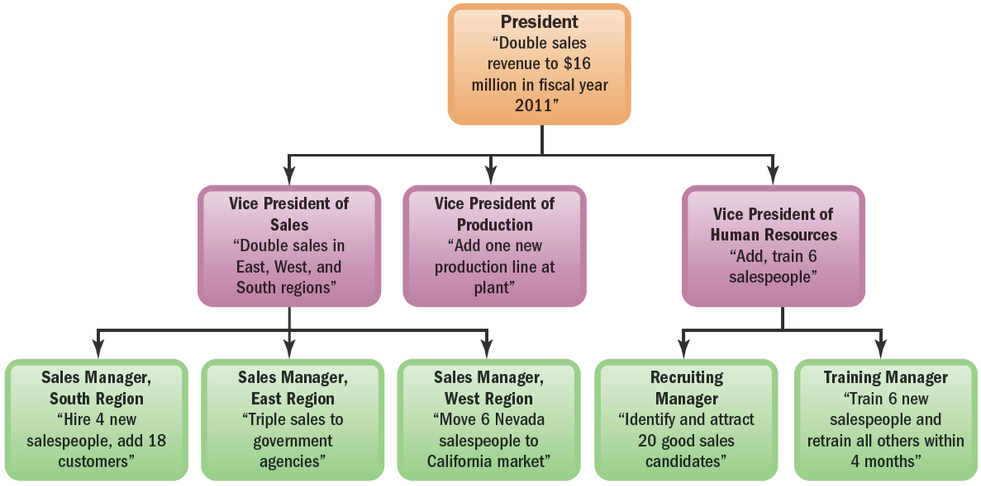
FIGURE 3–1 Sample Hierarchy of Goals Diagram for a Company
Notes:
The Hierarchy of Goals
In well-run companies, the goals from the top of the organization down to where you’re working should form an unbroken chain (or “hierarchy”) of goals.
The hierarchy of goals diagram in Figure 3-1 summarizes this. At the top of the company, the president and his or her staff set strategic goals. Lower-level managers (in this case, vice presidents) then set goals (such as “Add one production line at Plant A”).
Without a clear plan at the top, no one in the company would have the foggiest notion of what to do. At best, you’d all be working at cross-purposes.

Slide 6
Fundamentals of Management Planning
The Planning Process
1
Set an objective.
2
Make forecasts and check assumptions.
3
Determine/develop alternative courses of action.
4
Evaluate the alternatives.
5
Implement and evaluate your plan.
Notes:
The Planning Process
People make plans every day, often without giving it a thought. We plan our routes to school, what courses to take, and what to do on Saturday night. Underlying all those plans, however, is an often unstated planning process. Once implemented, plans must be evaluated to see if they must be revised to better fit changing competitive conditions.

Slide 7
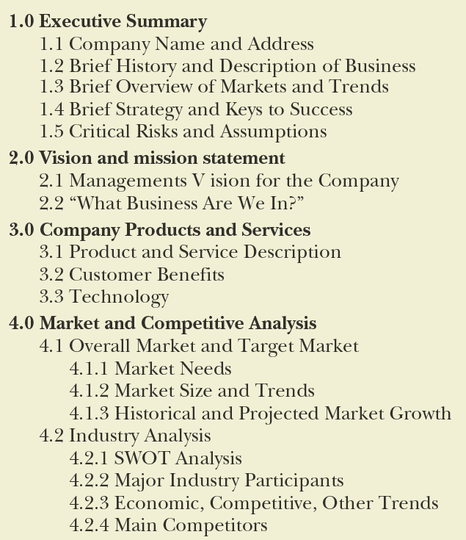
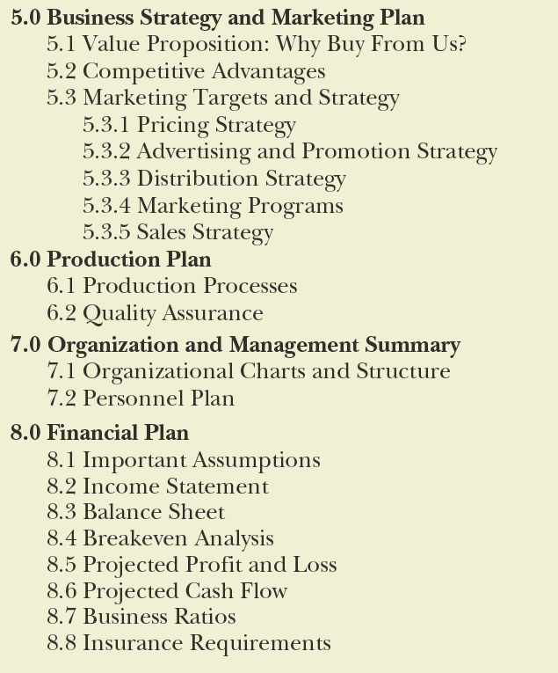
FIGURE 3–2 Business Plan Table of Contents
Notes:
Putting Together the Business Plan
The business plan provides a comprehensive view of the firm’s situation today and of its company-wide and departmental goals and plans for the next 3 to 5 years. Larger firms label their plans “strategic plans.”
There are no rigid rules regarding what such plans must contain. However, they usually include, at a minimum, (1) a description of the business (including ownership and products or services), (2) the marketing plan, (3) the financial plan, and (4) the management and/or personnel plan. Figure 3-2 displays the contents of a typical business plan.

Slide 8
How Managers Set Objectives: SMART Goals
S
Specific
M
Measureable
A
Attainable
R
Relevant
T
Timely
Notes:
Setting SMART Goals
Setting effective goals is an essential management skill. Experienced managers have a simple and effective way to check whether their goals are good or not—they use the acronym “SMART.”
Good goals are specific (make clear what to achieve), measurable, attainable; relevant (in terms of what you’re setting the goal for), and timely (they have deadlines and milestones).

Slide 9
How to Set Motivational Goals
Motivational Goal Setting
Assign specific goals
Assign measurable goals
Assign challenging but doable goals
Encourage employee participation

Slide 10
Using Management by Objectives (MBO)
The MBO Process
1
Set overall organizational goals.
2
Set departmental (supporting) goals.
3
Discuss departmental goals with subordinates.
4
Set individual goals and timetables.
5
Give feedback on progress toward goal.
Notes:
Management by Objectives (MBO)
The supervisor and subordinate jointly set goals for the latter and periodically assess progress toward those goals.
MBO has benefits. It provides a simple process for working through how the goals at each level will relate to those above and to those below. It also capitalizes on the advantages of employee participation.
The downside is that MBO is time consuming. These programs often involve numerous meetings among employees and supervisors, and then extensively documenting each person’s goals in various electronic or hard-copy formats. All that takes time.

Slide 11
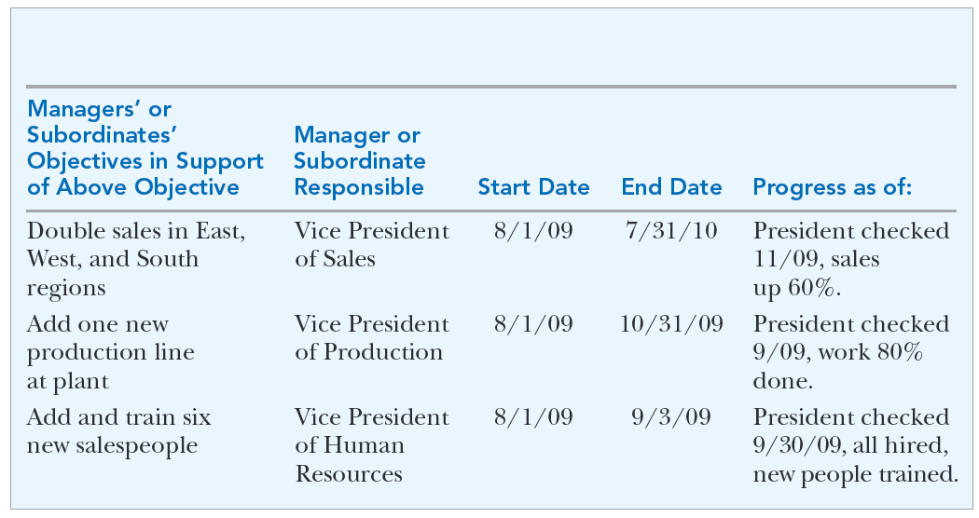
FIGURE 3–4 Management Objectives Grid
Company-Wide or Departmental Objective: Double sales revenue to $16 million in fiscal year 2011
Notes:
The management objectives grid in Figure 3-4 spells out each department manager’s assigned goals in support of achieving the firm’s overall goals. In this case, one long-term top management goal is to “Double sales revenue to $16 million in fiscal year 2011.” The grid summarizes the goals each department must achieve if the firm is to meet its overall $16 million sales goal.
Managers use the management objectives grid:
To show each of your department manager’s goals and to list their supporting goals.
To clarify what their own goals should be, given the firm’s goals.
To summarize for their subordinates what their goals are, in light of the department’s goals.
As a quick way to track subordinates’ progress using the grid’s start and end dates.

Slide 12
WHY STRATEGY
To maintain a competitive position in the marketplace, a company must have a long-range plan.
This plan needs to include the company’s
long-term goals,
an understanding of the market place,
a way to differentiate itself from its competitors.
All other decisions made by the company must support this long-range plan.
Otherwise, each person in the company would pursue goals that he or she considered important, and the company would quickly fall apart.
The functioning of a football team on the field is similar to the functioning of a business

Slide 13
The Strategic Management Process
Strategy
A course of action the organization intends to pursue to achieve its strategic aims.
Strategic Plan
How an organization intends to match its internal strengths and weaknesses with its external opportunities and threats to maintain a competitive advantage over the long term.
Strategic Management
The process of identifying and executing the organization’s mission by matching its capabilities with the demands of its environment.
Leveraging
Capitalizing on a firm’s unique competitive strength while underplaying its weaknesses.
Notes:
In practice, determining what the organization’s long-term, overall plan should be requires some special tools. For example, you need to be able to systematically review the competitive landscape and analyze what your best strategic, long-term courses of action might be. Strategic planning, which we turn to now, provides these special tools. We’ll start with some definitions.

Slide 14
Business Vision and Mission
Vision
A general statement of an organization’s intended direction that evokes emotional feelings in organization members.
Mission
Spells out who the firm is, what it does, and where it’s headed.
Notes:
Managers sometimes formulate a vision statement to summarize how they see the essence of their business down the road. The vision statement is a general statement of the firm’s intended direction and shows, in broad terms, “what we want to become.”
Whereas vision statements usually describe in broad terms what the business should be, the firm’s mission statement summarizes its answer to the question, “What business are we in?”
Managers often use the mission statement to pinpoint whether and how the firm will vertically integrate, as well as the firm’s product scope (diversity), geographic coverage, and competitive advantage.

Slide 15
Mission Statement for Nestle
Nestlé is... ...the world's leading nutrition, health and wellness company. Our mission of "Good Food, Good Life" is to provide consumers with the best tasting, most nutritious choices in a wide range of food and beverage categories and eating occasions, from morning to night

Slide 16
Key Examples
Mission: Dell Computer- “to be the most successful computer company in the world”
Environmental Scanning: political trends, social trends, economic trends, market place trends, global trends
Core Competencies: strength of workers, modern facilities, market understanding, best technologies, financial know-how, logistics

Slide 17
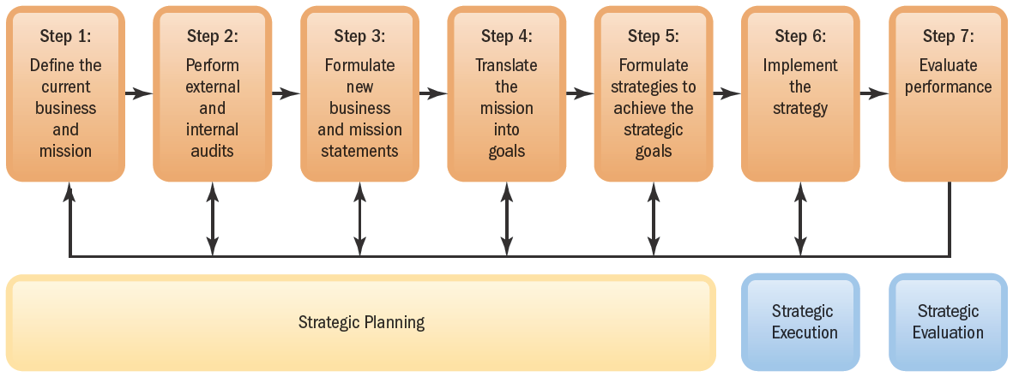
FIGURE 3–5 The Strategic Management Process
Notes:
The Strategic Management Process
Figure 3-5 sums up the strategic management process. This includes (1) defining the business and developing a mission, (2) evaluating the firm’s internal and external strengths, weaknesses, opportunities, and threats, (3) formulating a new business direction, (4) translating the mission into strategic goals, and (5) formulating strategies or courses of action. Step (6) and Step (7) entail implementing and then evaluating the strategic plan.

Slide 18
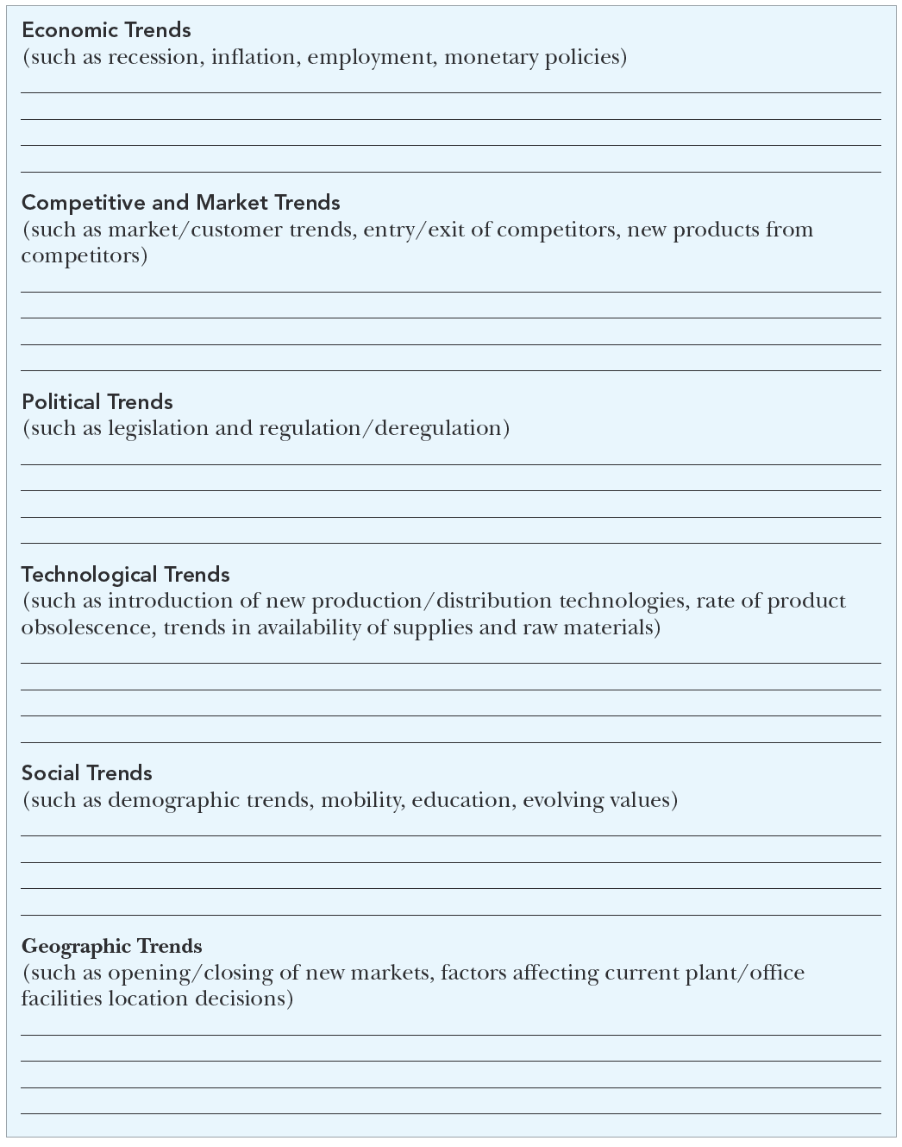
FIGURE 3–6 Worksheet for Environmental Scanning
Notes:
The environmental scanning worksheet in Figure 3-6 is a simple guide for compiling relevant information about the company’s environment. This includes things like economic, competitive, and political trends that have an effect on the company and its strategy for competing in its market.

Slide 19
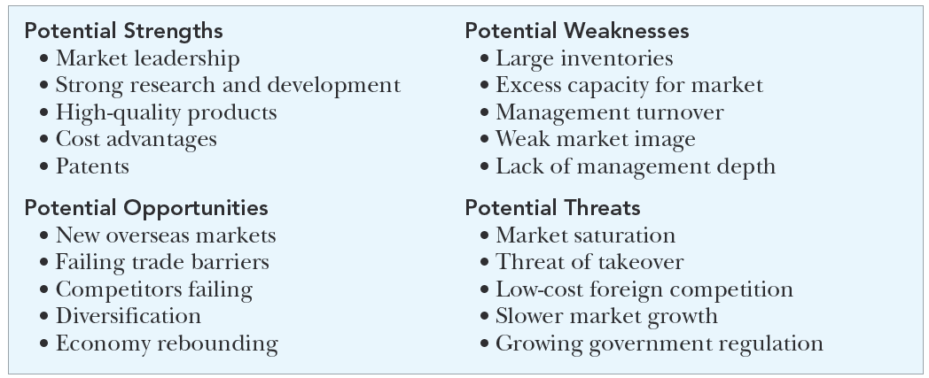
FIGURE 3–7 SWOT Matrix, with Generic Examples
Notes:
The SWOT chart in Figure 3-7 is used in strategic planning by managers to compile an estimate of the company strengths, weaknesses, opportunities, and threats when creating the firm’s strategy.
SWOT helps identify the factors that will allow a company to differentiate its product or service from those of its competitors to increase market share and gain a competitive advantage.

Slide 20
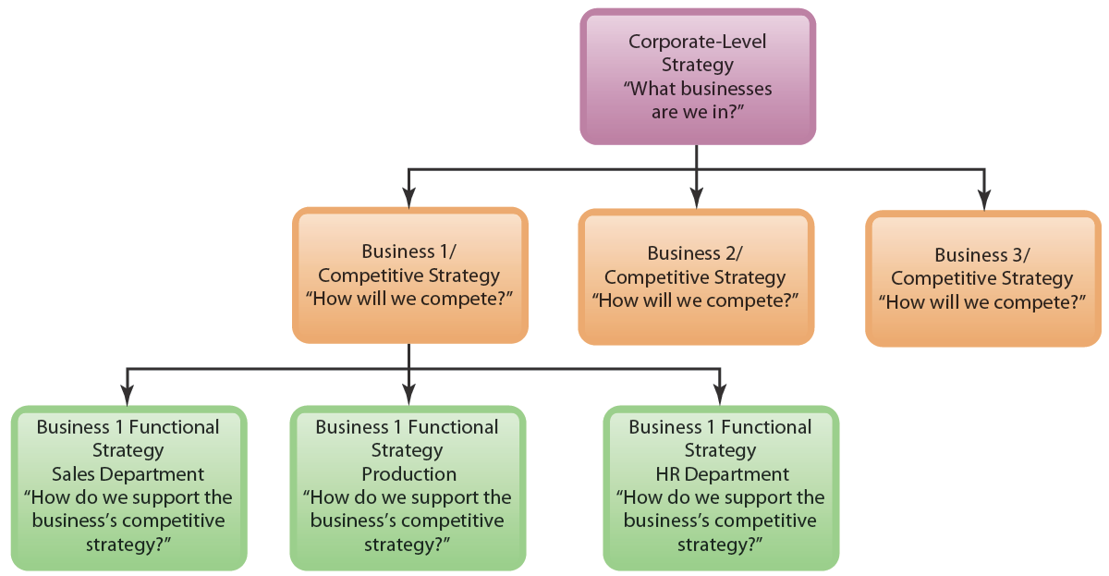
FIGURE 3–8 Type of Strategy at Each Company Level
Notes:
In Figure 3-8 we see the three types of strategies that managers use, one for each level of the company. There is corporate-wide strategic planning, business unit (or competitive) strategic planning, and functional (or departmental) strategic planning.

Slide 21
Types of Corporate Strategies
Corporate Strategy Possibilities
Concentration
Diversification
Consolidation
Vertical integration
Geographic expansion
Notes:
With a concentration (single business) strategy, the firm offers one product or product line, usually in one market. Concentration growth strategies include market penetration, product development, and horizontal integration.
A related diversification strategy implies that the firm will expand by adding new product lines and diversifying so that a firm’s lines of business still possess some kind of fit.
A conglomerate (unrelated) diversification strategy means diversifying into products or markets not related to a firm’s current businesses or to one another.
A vertical integration strategy means the firm expands by, perhaps, producing its own raw materials, or selling its products direct.
A consolidation strategy focuses on reducing a firm’s size.
Geographic expansion is taking the business abroad.

Slide 22
Types of Competitive Strategies
Business-Level Competitive Strategies
Cost leadership
Differentiation
Focus/Niche
Notes:
Cost leadership means that a firm is seeking to become the overall low-cost leader in an industry.
Firms using a differentiation strategy seek to be unique in their industry along competitive dimensions that are widely valued by buyers.
Focusers are firms that attempt to compete in a narrow market segment (niche) through the provision of a product or service that specify customers can get in no other way.

